Slide 1
Multi-Tenancy
Development, Challenges & Solutions.

Slide 2

About Me
& My Company & My Projects

Slide 3

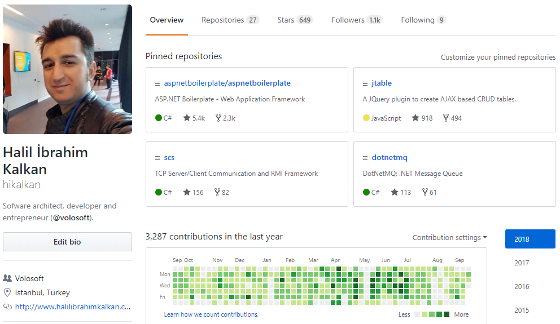
Halil İbrahim Kalkan
Github @hikalkan
Twitter @hibrahimkalkan
Email halil.kalkan@volosoft.com

Slide 4

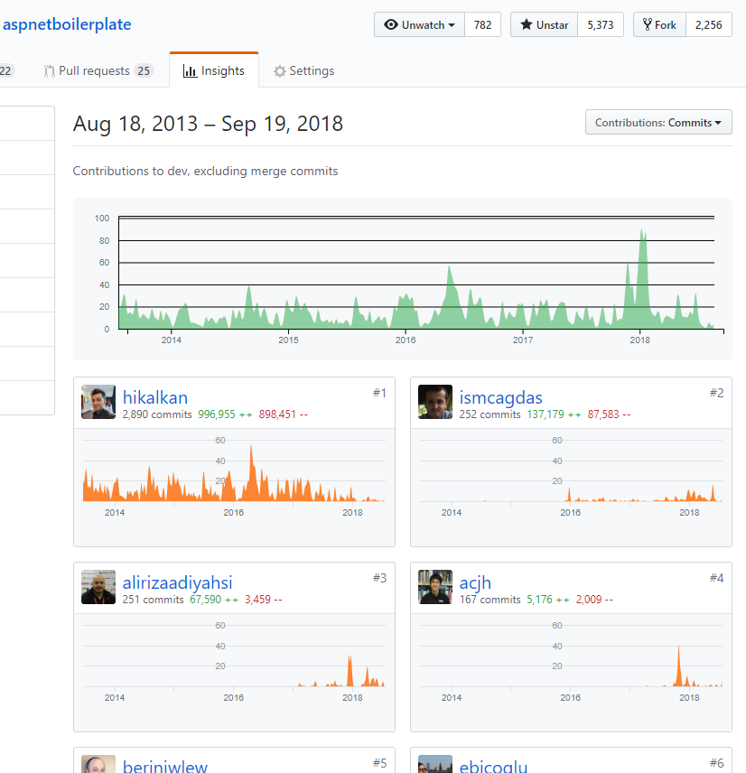
aspnetboilerplate.com
5+ years of continuous development.
5,350+ stars on Github (TODO: UPDATE SCREENSHOT)
650,000+ downloads on Nuget.

Slide 5

SaaS
Software as a Service

Slide 6
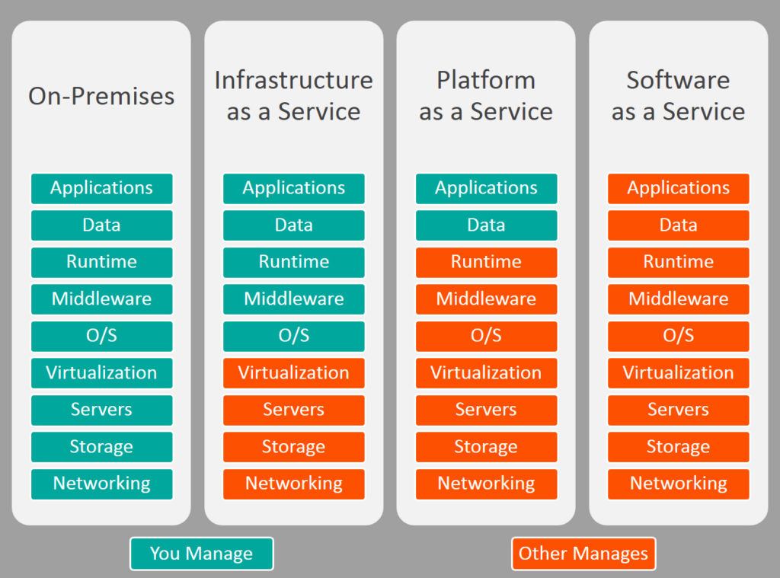


On-Premise / IaaS / PaaS / SaaS

Slide 7
SaaS Concepts
Tenant: An organization that uses the application/service (and pay for it).
Host: The organization that is responsible to provide the service and manage all the tenants.

Slide 8
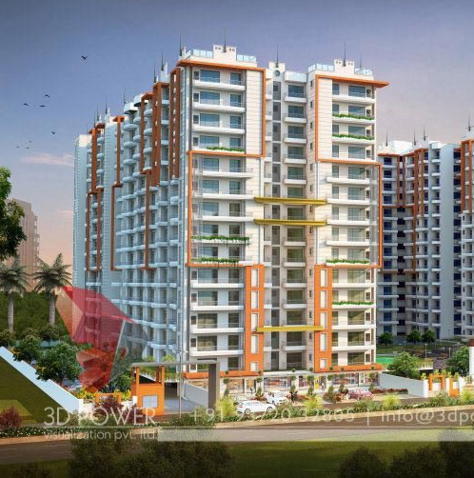
Why Multi-Tenancy?
Maximum Utilization.
Low Costs.
Easy to add a new client (tenant).
All clients use the same application & version.
Reduces maintenance & upgrade costs.

Slide 9

Difficulties
Data Isolation.
Performance: One tenant’s heavy usage may effect the other tenants.
Different client requirements, configuration & customization.
Security.
Backup (per tenant?)

Slide 10

Multi-Tenancy
High-Level Architecture

Slide 11
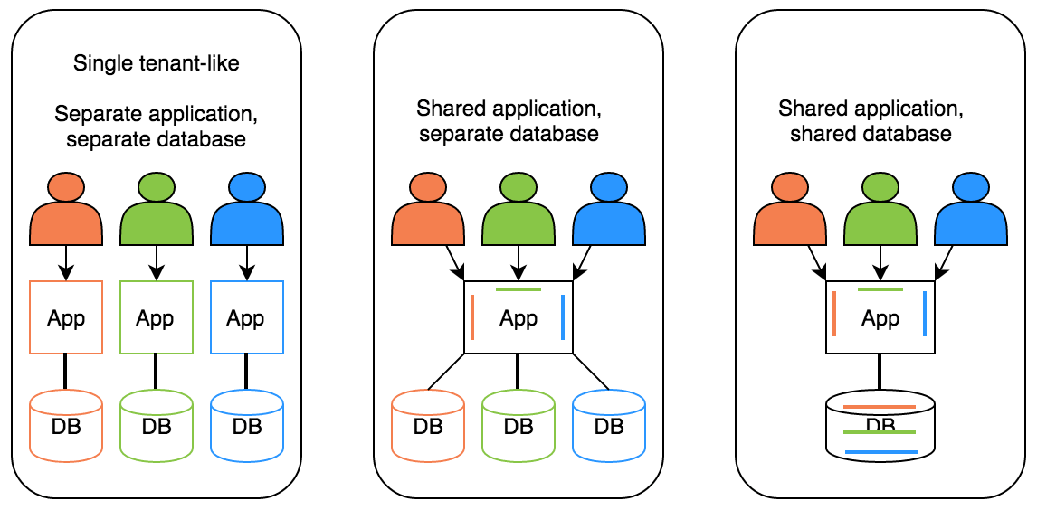
Deployment / Database Options
Hybrid

Slide 12
Ideal Multi-Tenant Application
Works exactly like on-premise: Separated users, permissions, data…
Should be able to work as on-premise too.
Should be developed independent from multi-tenancy. Multi-tenancy should be implemented in the infrastructure/framework.

Slide 13
Stateless Application Design
Application should be stateless!
Main state origins:
Http Request: Cookie, header, querystring, payload…
Authentication Ticket
Database: Relational, non-relational, file system…
Cache: Distributed caches like Redis, Memcached.

Slide 14

Multi-Tenancy
Determine the Current Tenant

Slide 15
Determine the Current Tenant
Sources
Current Claims (if user has been authenticated)
Subdomain (or domain): https://tenancy-name.mydomain.com
Http Header: _tenant = “acme” (for API clients & SPAs)
Http Cookie: _tenant = “acme” (for MVC applications)

Slide 16
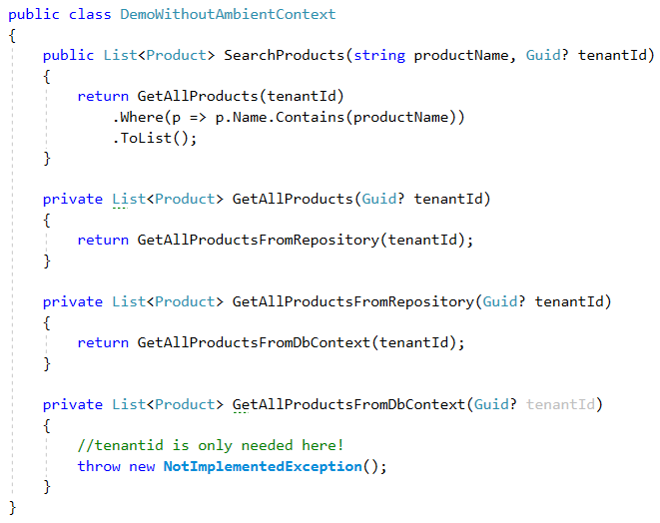
Ambient Context Pattern (without it)

Slide 17
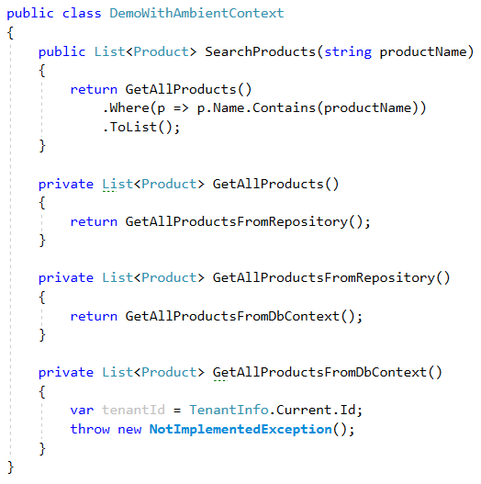
Ambient Context Pattern

Slide 18
Ambient Context Examples
HttpContext (IHttpContextAccessor)
CultureInfo.CurrentUICulture / Thread.CurrentThread.CurrentUICulture
Thread.CurrentPrincipal

Slide 19
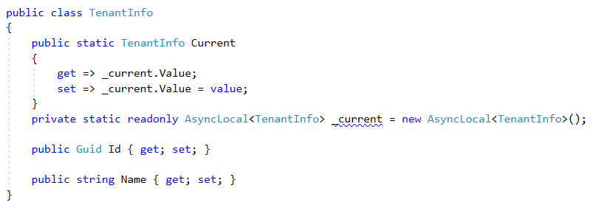
Implementation using AsyncLocal<T>

Slide 20
AsyncLocal<T> Alternatives
Public static … Multi-threading problem!
HttpContext: Web-depended!
ThreadStatic / ThreadLocal<T>: Not async/await friendly!

Slide 21
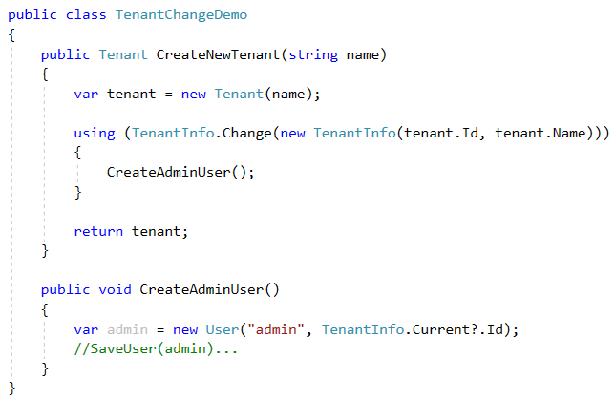
Change Current Tenant

Slide 22
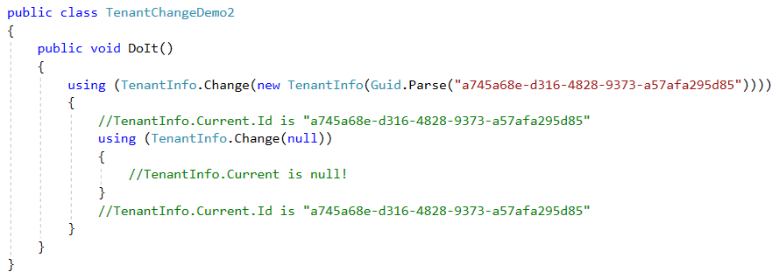
Change Current Tenant (Nested)

Slide 23
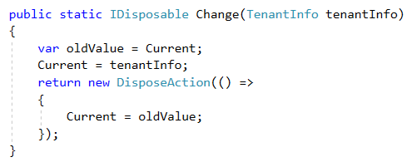
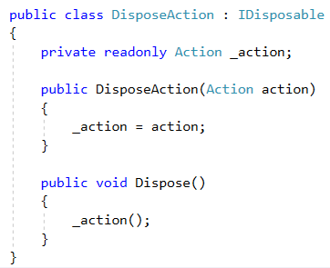
Change Current Tenant

Slide 24
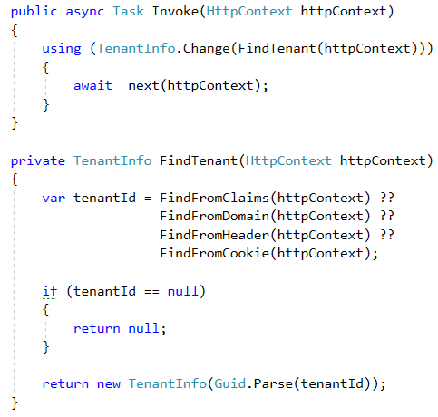
Multi-Tenancy Middleware Implementation

Slide 25
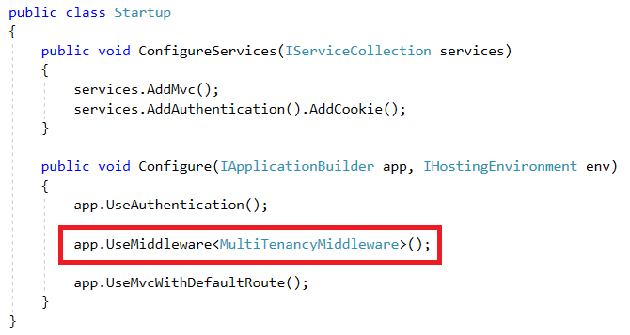
ASP.NET Core Multi-Tenancy Middleware

Slide 26
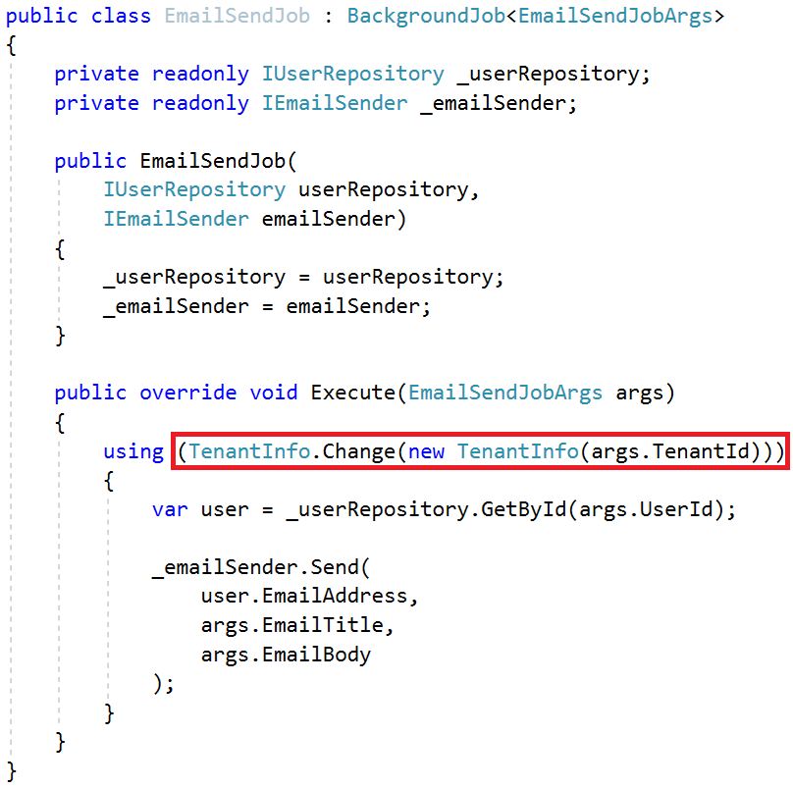
Change Tenant in a Background Job

Slide 27

Multi-Tenancy
Database / Data Isolation

Slide 28
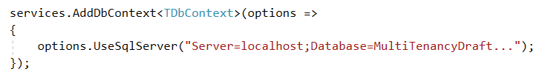
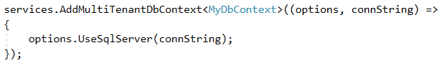
Dynamically Select the Connection String

Slide 29
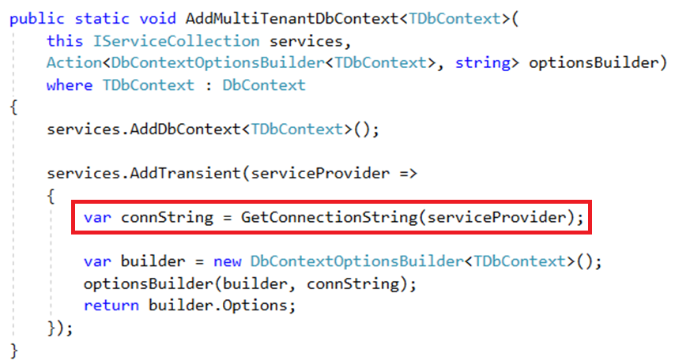
Dynamically Select the Connection String

Slide 30
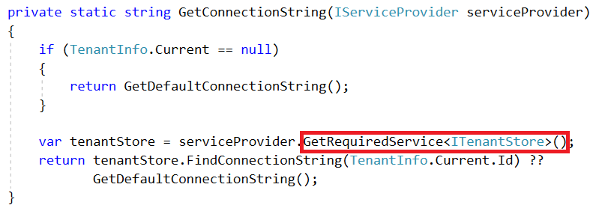
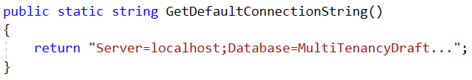
Dynamically Select the Connection String

Slide 31
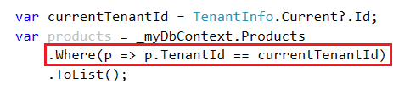
Data Filtering: Manual Way

Slide 32
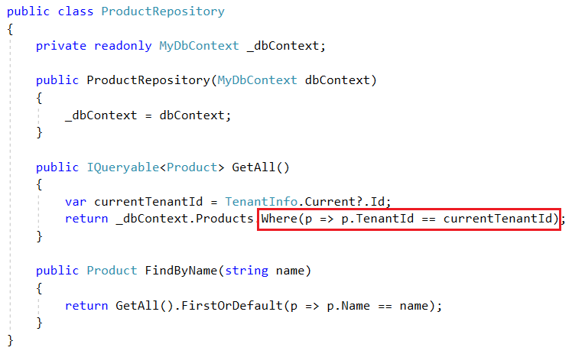
Automatic Data Filtering: Repository Pattern

Slide 33
Automatic Data Filtering: Repository Pattern
Pros
Easy to implement (especially using generic repository pattern - IRepository<TEntity>).
ORM Independent (can be implemented for any ORM that supports IQueryable).
Central data-access
Cons
Limited – Can be bypassed by directly using DbContext.
Limited – Does not work for navigation properties.
Open to leak (Repository developer may forget it).

Slide 34
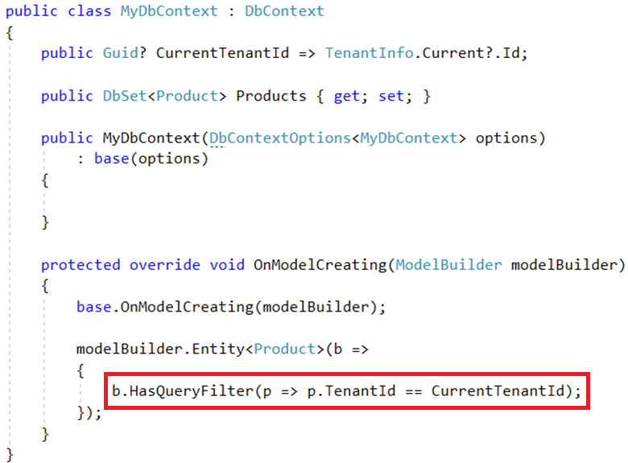
Automatic Data Filtering: EF Core Global Filters

Slide 35
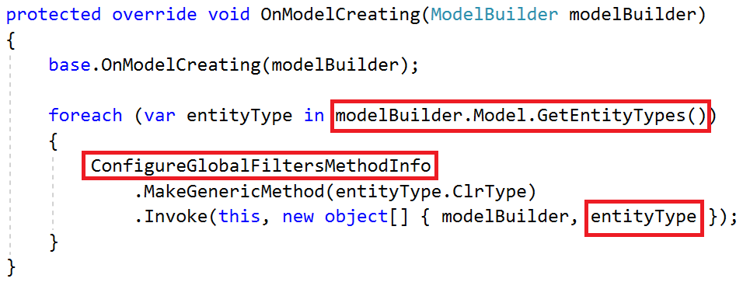
Automatic Data Filtering: EF Core Global Filters

Slide 36
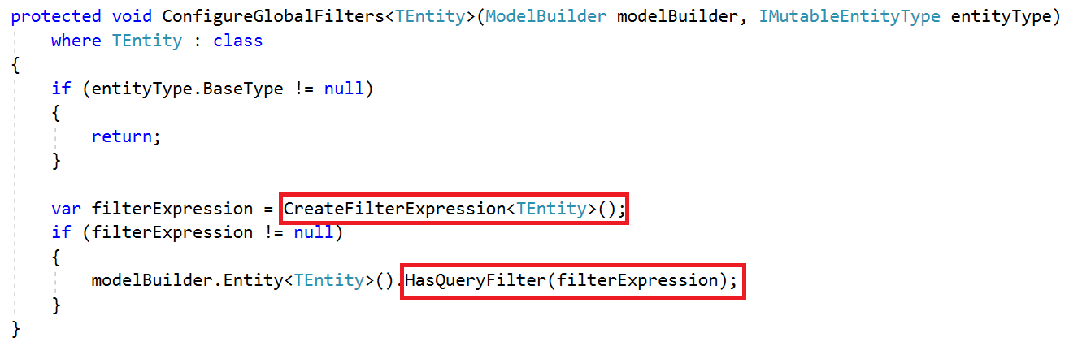
Automatic Data Filtering: EF Core Global Filters

Slide 37
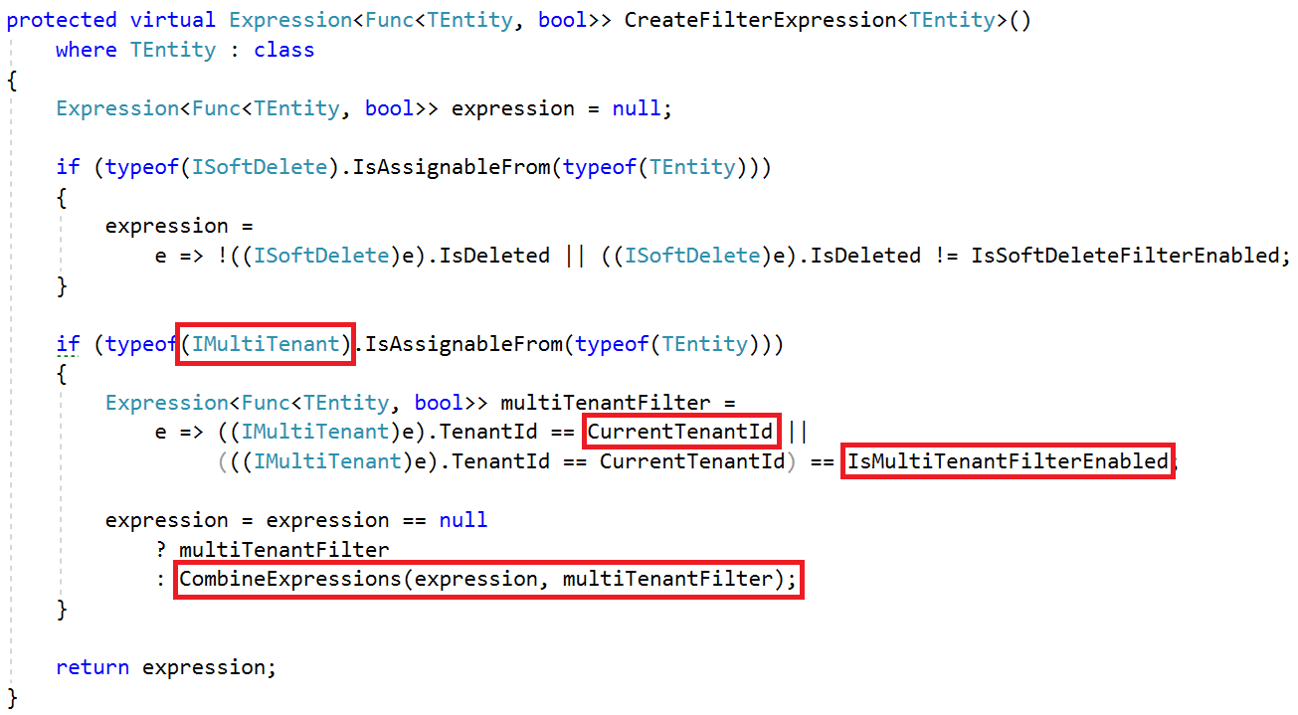
Automatic Data Filtering: EF Core Global Filters

Slide 38
Automatic Data Filtering: EF Core Global Filters
Pros
Natively works with EF Core.
Supports navigation properties as well.
Cons
Limited – does not support multiple filters and enable/disable individually (possible via workarounds – may be directly supported in the future).
Limited – Does not work if you directly work with SQL, stored procedures… etc.
Not available for all ORMs and data access APIs (but available for EF Core, NHibernate and even for EF 6.x)

Slide 39
Automatic Data Filtering: Other Options
Row Level Security – Available for SQL Server and Azure SQL Database.
Pros: Completely integrated to DBMS. Works for everything.
Cons: Relatively complex to implement. Specific to DBMS.
Azure Elastic Database Pool
Pros: Dynamically create databases per tenant. Easily scale.
Cons: Only for db per tenant scenario. Has it’s own API. Has limitations.

Slide 40
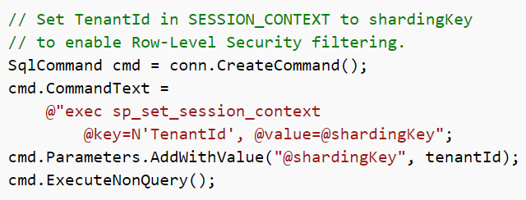
Automatic Data Filtering: Row Level Security
Set Session Context while changing the current tenant:

Slide 41
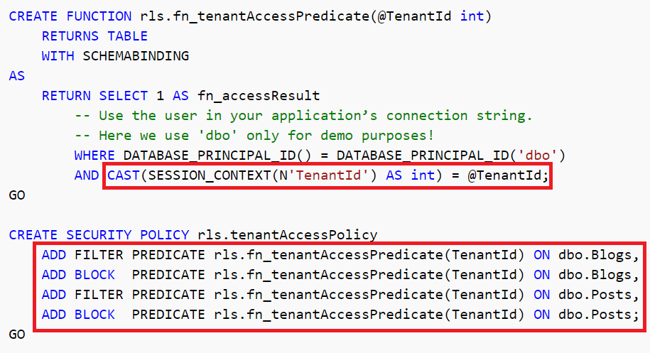
Automatic Data Filtering: Row Level Security
Create a policy to filter/block data

Slide 42
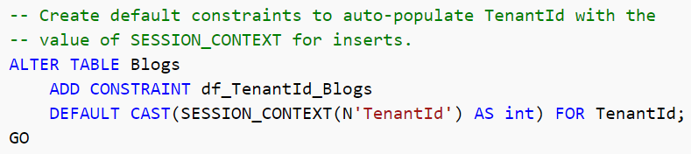
Automatic Data Filtering: Row Level Security
Automatically set TenantId for new entities

Slide 43
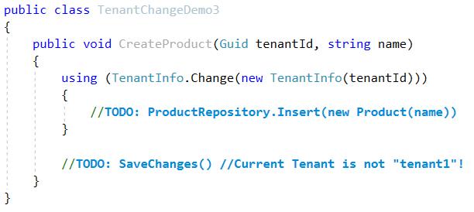
Setting Tenant Id for New Entities
In DbContext.SaveChanges()
Get new entities for change tracker, find IMultiTenant entities, set current TenantId.
Problem: May set wrong tenantId.

Slide 44
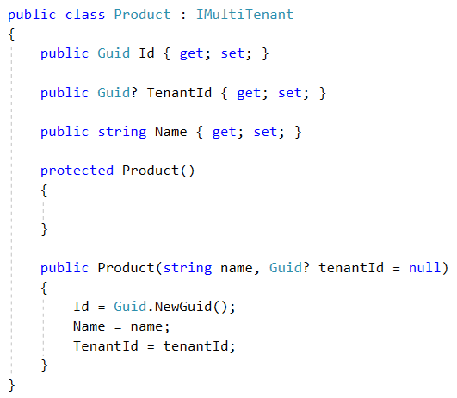
Setting Tenant Id for New Entities

Slide 45
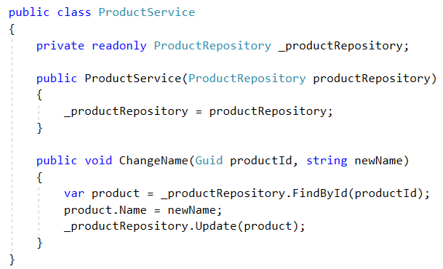
Safe Way to Manipulate Data

Slide 46

Multi-Tenancy
Cache Isolation

Slide 47
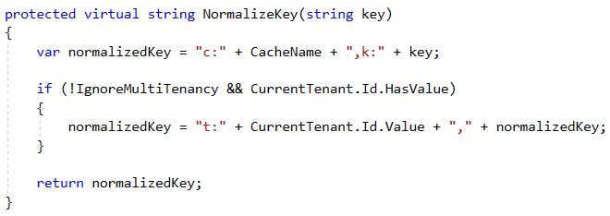
Cache Isolation
Key/Value Caches may share same data space for all tenants.
Tenants may want to cache same type of data with same id (unique per tenant).

Slide 48
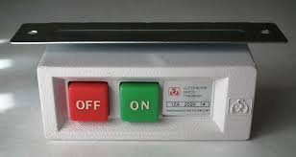
Multi-Tenancy
Enable/Disable

Slide 49
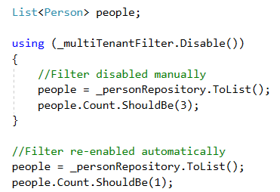
Disable/Enable By Scope
May need to query on all tenants.
Can be implemented using ambient context pattern.
Problem: Not easy for multi-database scenario.

Slide 50

Multi-Tenancy
Database Transactions

Slide 51
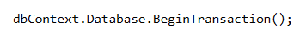
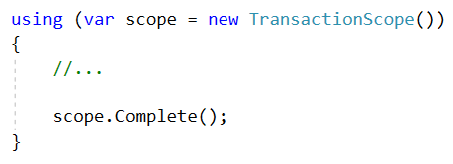
Single Database / Multiple DbContext
Multiple dbcontext can share single connection & transaction!
EF Core 2.1 supports TransactionScope

Slide 52
Multiple Database / Distributed Transactions
Multi-tenant (or host + tenant) operations may require distributed transactions with database per tenant approach.
SQL Server can handle but requires to run MSDTC.
May not be possible for cloud platforms.
Avoid where possible, or use event queues or some other async mechanism.

Slide 53

Multi-Tenancy
Database Migrations

Slide 54
Schema / Data Migration
Problem for multiple-databases.
Solution: Upgrade all in one with a custom tool.
Pros: Easy to implement. All tenants are in the same version.
Cons: May get too long time for big number of tenants and data. All tenants wait for all upgrade progress.
Solution: Upgrade the application servers immediately, upgrade databases individually on first access.
Pros: Upgrading is distributed to time. A tenant does not wait for another.
Cons: First accessing user may wait too much. Even we get timeout exception. Also, we don’t control the upgrade speed.

Slide 55
Schema / Data Migration
Solution: Multiple versions concurrently.
Split the application servers into two parts: Upgraded tenants use the new application, other tenants use the old application.
Pros:
Minimum waiting for every tenant.
Upgrading may be scheduled for every individual tenant and they can be informed.
Allows us to perform A/B tests and previews.
Cons
Requires multiple application servers – but reasonable for a big system.
Harder to implement, maintain and monitor.

Slide 56

Multi-Tenancy
Optimizations & Integrations

Slide 57
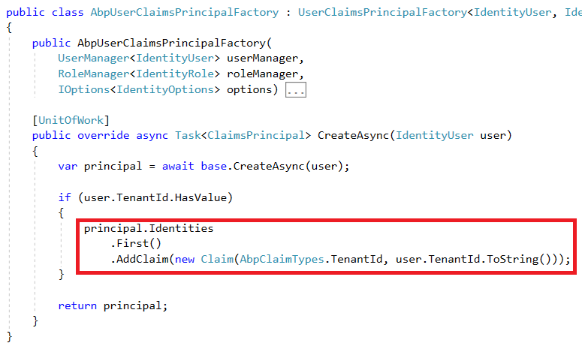
ASP.NET Core Identity Integration

Slide 58
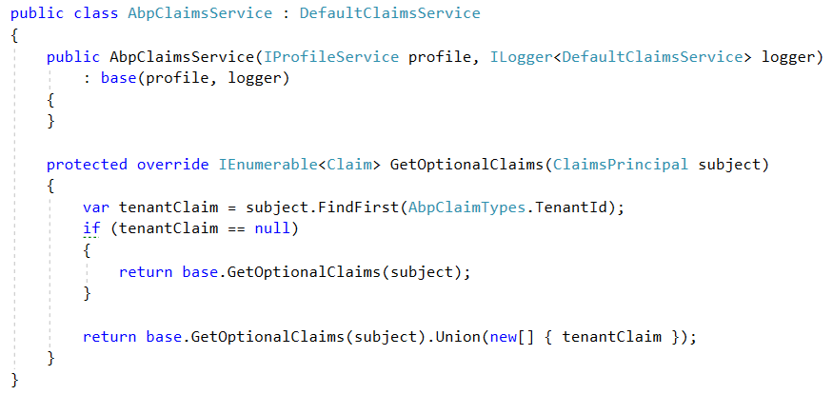
IdentityServer4 Integration

Slide 59
Partition Tables / Indexes by TenantId
Create partitions for all (or big) tables by TenantId.
Or Create TenantId indexes.

Slide 60
Multi-Tenancy
SaaS Features

Slide 61
Feature / Package / Subscription System
Define features of the application. Feature Types:
On/Off: Excel export, Replying by email (for a support app)…
Numeric:10 users, 20,000 emails/month…
Selection: one of the available options.
Group features into packages/editions.
Subscribe packages by tenants.
Check features: Declarative or by code

Slide 62
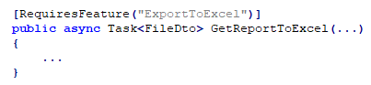
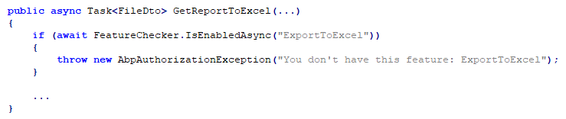
Feature Checking

Slide 63
Declarative Feature Check Implementation Options
MVC Action Filters
Easy to implement. Naturally works within ASP.NET Core.
Limited to Controller actions.
Method Interception using dynamic proxying (interception).
Works everywhere.
Limited to virtual methods.
Weaving: Mono.Cecil, Fody, Postsharp… etc.

Slide 64
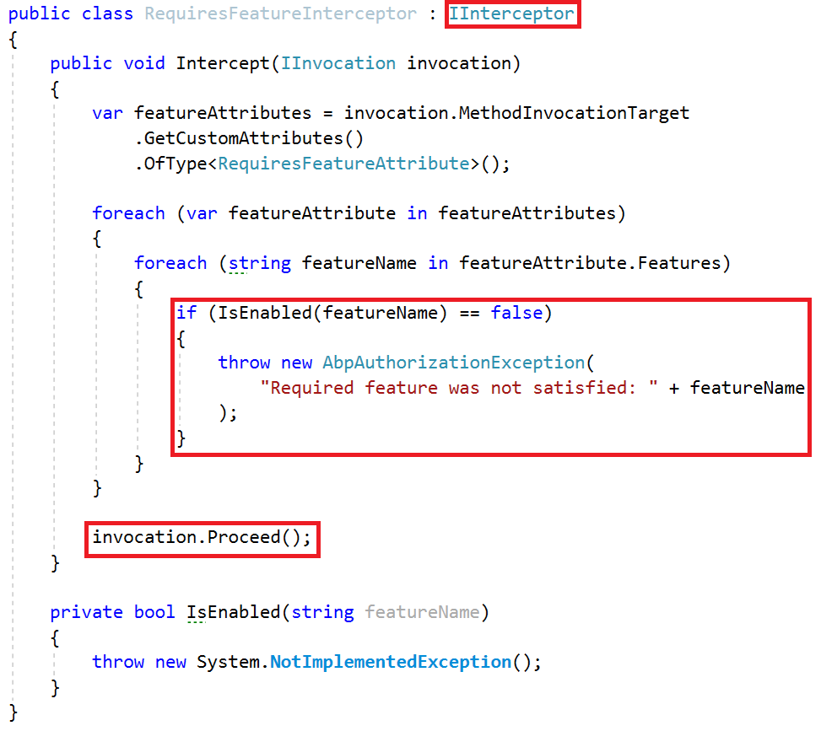
Declarative Feature Check: Interception

Slide 65
Thank you…
Github @hikalkan
Twitter @hibrahimkalkan
Email halil.kalkan@volosoft.com

